Slide 1
Integrator Naming Convention
Simplify Planning, Reporting & Analytics

Slide 2
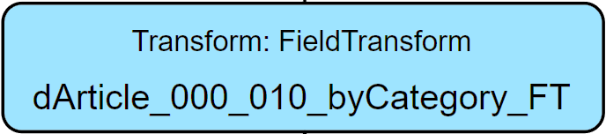
Overview

Slide 3
Overview
I.
II.
III.
IV.
V.
Identifier of integration task
Trace index
Component index
Trace descriptor
Component Type

Slide 4
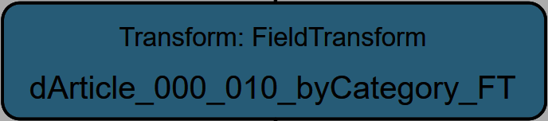
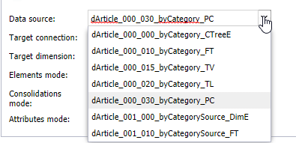
I. Identifier of integration task
The first part of a name of an extract, transform or load is a unique identifier, which describes briefly the target of this integration task (e.g. load of a specific dimension, cube, table etc.).
Purpose is to cluster extracts, transforms and loads, which have the same objective. Hence all components with the same task share the unique identifier.
The first letter of a unique identifier declares the type of the target. E.g.:
  d → Dimension
  c → Cube
  t → Table

Slide 5


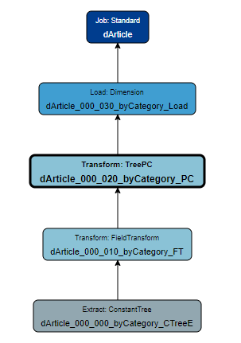
I. Identifier of integration task
For a better read, it is recommended to refrain from seperating characters in the task identifier but to write in one word and capitalize consecutive words:
dChartOfAccounts
dChart_of_Accounts
dChart-of-Accounts
Every trace with the same task identifier should be bundled in a job named as this task identifier:

Slide 6
I. Identifier of integration task
For a better read, it is recommended to refrain from seperating characters in the task identifier but to write in one word and capitalize consecutive words:
dChartOfAccounts
dChart_of_Accounts
dChart-of-Accounts
Every trace with the same task identifier should be bundled in a job named as this task identifier:
Note: Of course this should be applied only where it makes sense. For example if the loads of all dimensions are bundled in one job, the name would probably be „Dimensions“.

Slide 7
II. Trace index
The second part of the name is a 3-digit index, which uniquely identifies a trace within the integrator task. All components within the same trace share the same index.
The first digit defines a subtask within the overall task. This could be for example:
- Different parallel hierarchies of dimensions
      dArticle_000_... → All Articles by Category
      dArticle_100_... → All Articles by Creation Date
- Different KPIs or Versions of cube data
      cSales_000_... → Actual data
      cSales_100_... → Budget data
The second digit defines a further subtask within a subtask. For example:
      cSales_000_... → Slice deletion of Actual data
      cSales_010_... → Cube load of Actual data

Slide 8
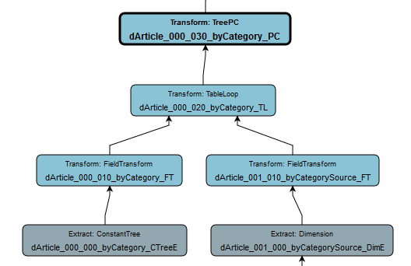
II. Trace index
The third digit defines a partially parallel trace in a subtask which leads into the main trace before it comes to the load. This could be for example:
    A loop source from a table loop transform
    An extract/transform, which is used in a field transform lookup
    An extract/transform, which is used in a table join

Slide 9
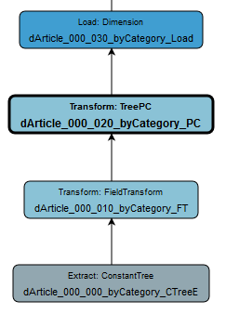
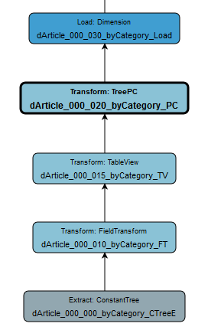
III. Component index
The third part of a components name is a 3-digit component index, which uniquely identifies a component within a trace. This index increases by intervals of ten to allow for adding additional components after the trace has been built:

Slide 10
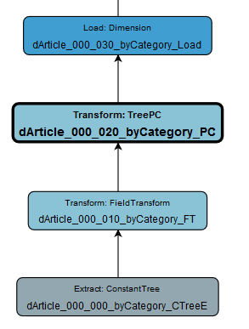
IV. Trace Descriptor
The component index is followed by a brief description of what is done in this trace. This description is free text and has only documentational function. If a task consists only out of one trace, it is not mandatory. If used, every component in the trace should share the same description.
Examples:
Name of the Parallel Hierarchy
KPI/Version which is loaded
Deletion
Note: Descriptions of what is done in a specific component should be stored in the description section of the respective component and not in its name.

Slide 11
V. Component type
The last part of a compnents name is an abbreviation of the component type.
  Extracts:
  Calendar → CalE
  Constant Table → CTableE
  Constant tree → CTreeE
  Cosmos SQL → CosmosE
  Count → CountE
  Cube → CE
  Cube Slice → SliceE
  Dimension → DimE
  Excel → ExcelE
  File → FE
  JSON → JsonE
  LDAP → LdapE
  Metadata → ME
  MongoDB → MongoE
  Qlik → QlikE
  Relational → RE
  Relational Table → RTableE
  Rule -> RuleE
  Salesforce object → SFOE
  Salesforce SOQL → SFSE
  XML → XE
  XML tree → XTreeE
  Transforms:
  Field List → FL
  Field Normalization → FN
  Field Transform → FT
  RScript → RS
  Table Aggregation → TA
  Table Denormalization → TD
  Table Join → TJ
  Table Loop → TL
  Table Normalization → TN
  Table Union → TU
  Table View → TV
  Tree Element → TE
  TreeFH → FH
  Tree Join → TreeJ
  Tree LE → LE
  Tree NC → NC
  Tree PC → PC
  TreeView → TreeV

Slide 12
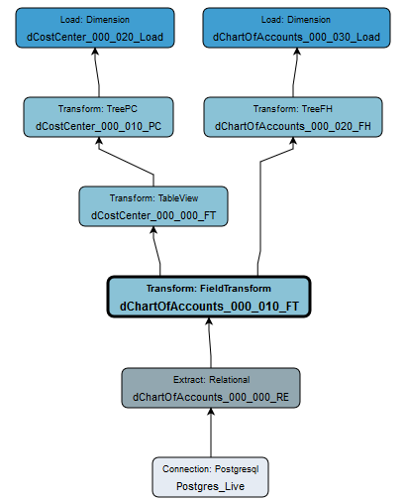



Additional notes (1)
In case data output of a component from an integrator task can be used by a different task, it is allowed to place the starting point of the latter on that component. This prevents redundancy and inflation of the integrator project.

Slide 13
Additional notes (2)
In case you have an extract with no specific filtering, which is shared by a lot of different integrator tasks, it is recommended to name this extract like the source being extracted.
Examples:
Extract of the „Month“-dimension with no specific filtering → Month_DimE
Relational extract with statement SELECT * FROM Tablename → Tablename_RE
Cube extract of exchange rates → FXRates_CE

